Slide 1
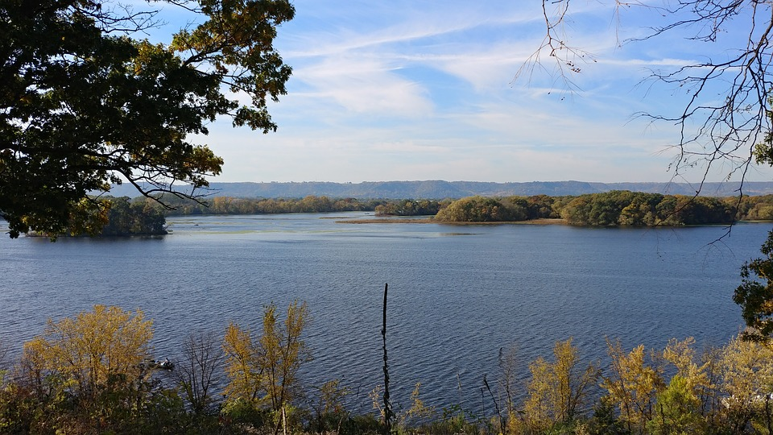
NPS River Vocab

Slide 2
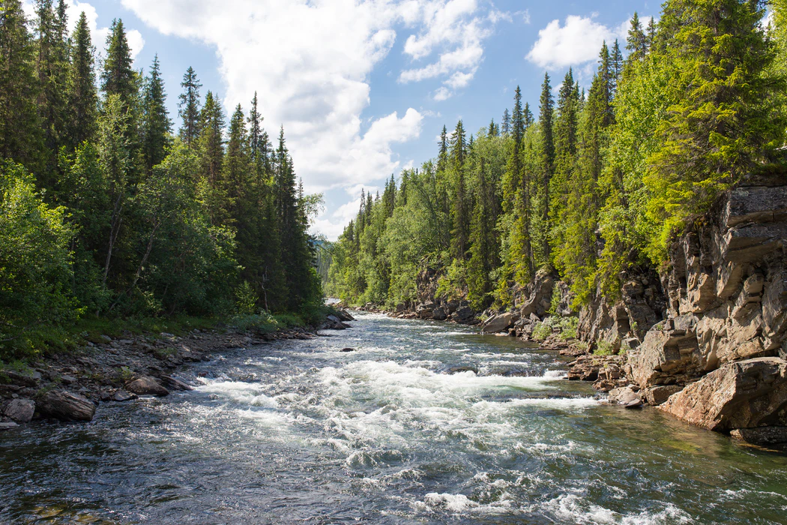
River
River - a moving stream of water.

Slide 3
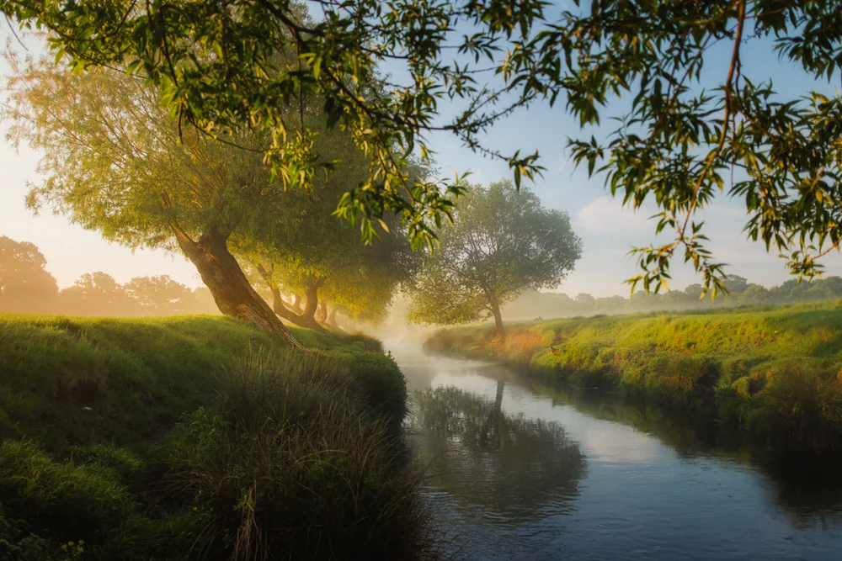
Riverbank
Riverbank - The ground on each side of a river.

Slide 4
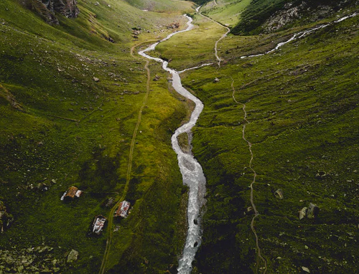
Channel
Channel -
a groove in the land that the river travels along.

Slide 5
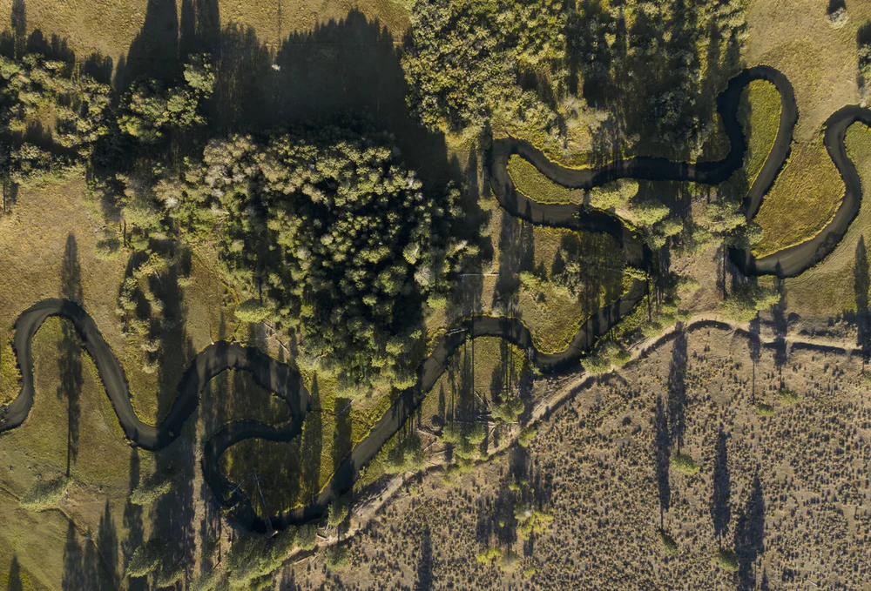
Meander
Meander - the bend in a river.

Slide 6
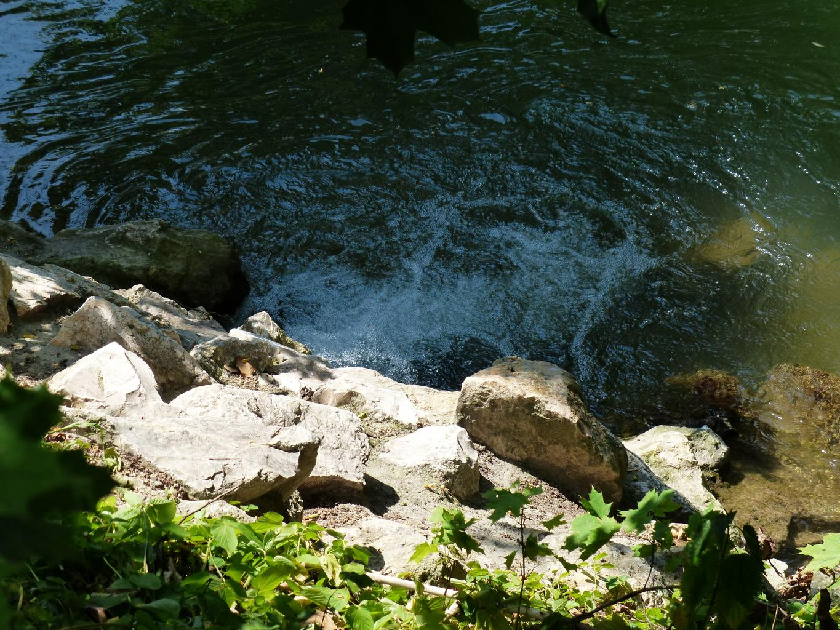
Source
Source - also called the headwaters, this is where a river begins.

Slide 7
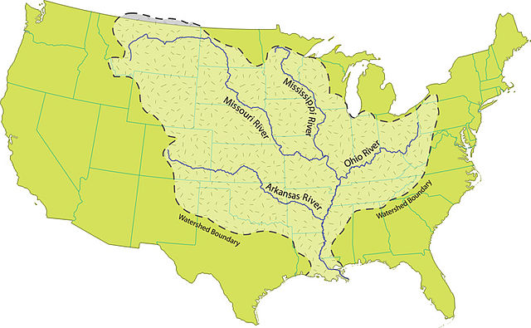
River Mouth
River mouth - the place where a river joins a larger body of water.

Slide 8
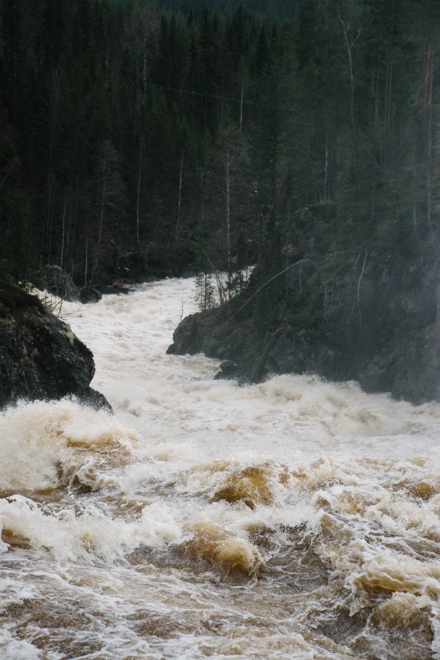
Downstream
Downstream - rivers flow from their source towards their mouth.

Slide 9
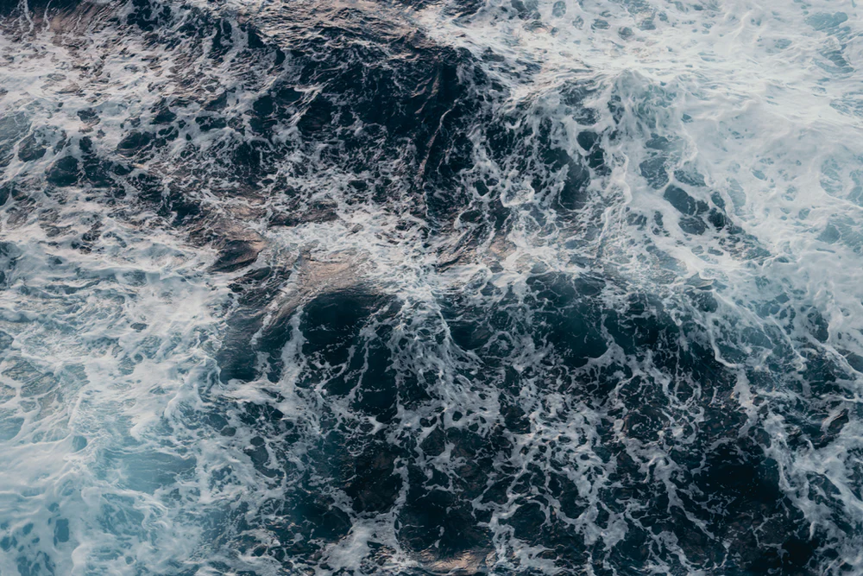
Current
Current - the pushing movement of the waves headed downstream.

Slide 10
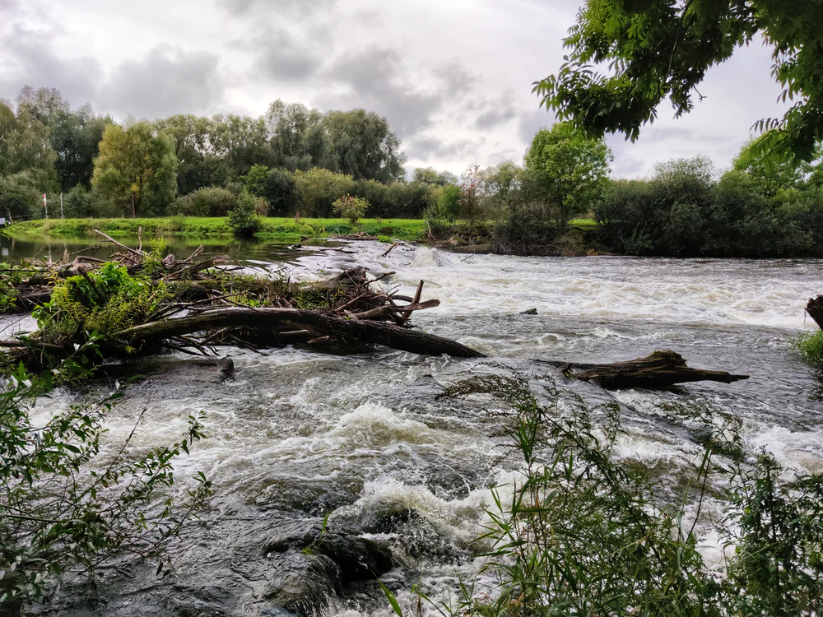
Flood
Flood - when there is too much water in a channel and the river overflows its banks.

Slide 11
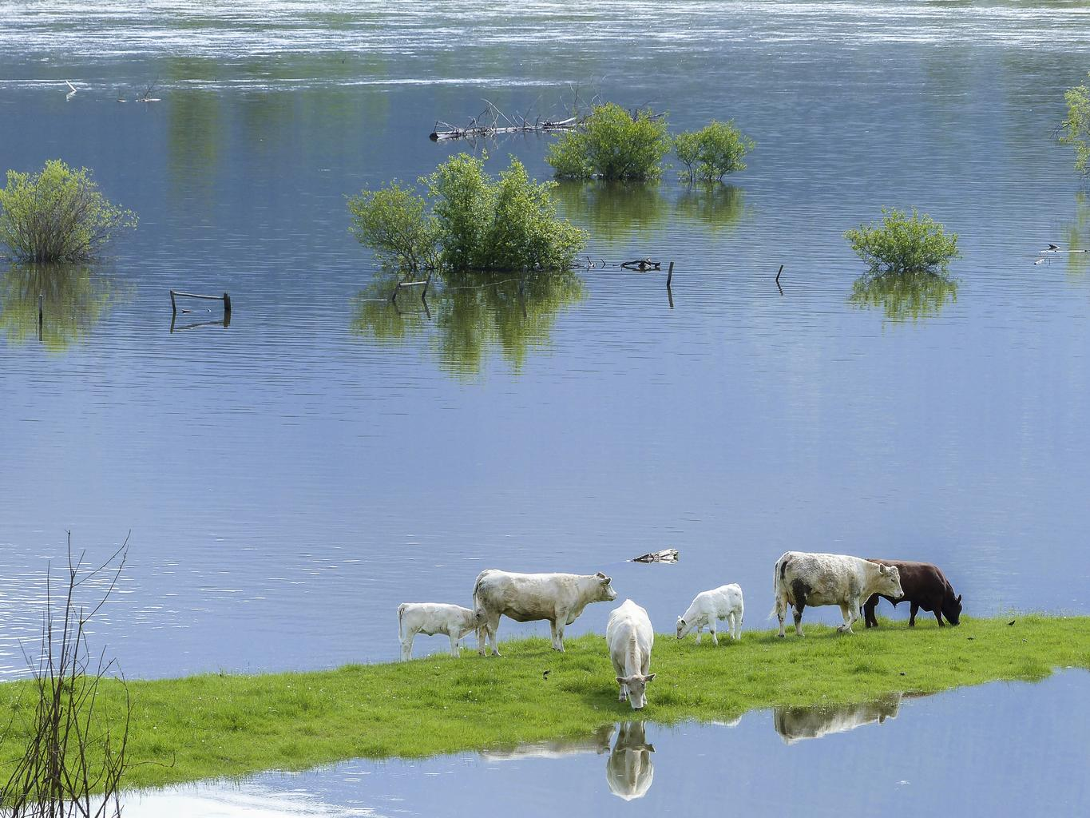
Floodplain
Floodplain - flat land next to the river that floods often. Floodplains make excellent farm land for growing crops.

Slide 12
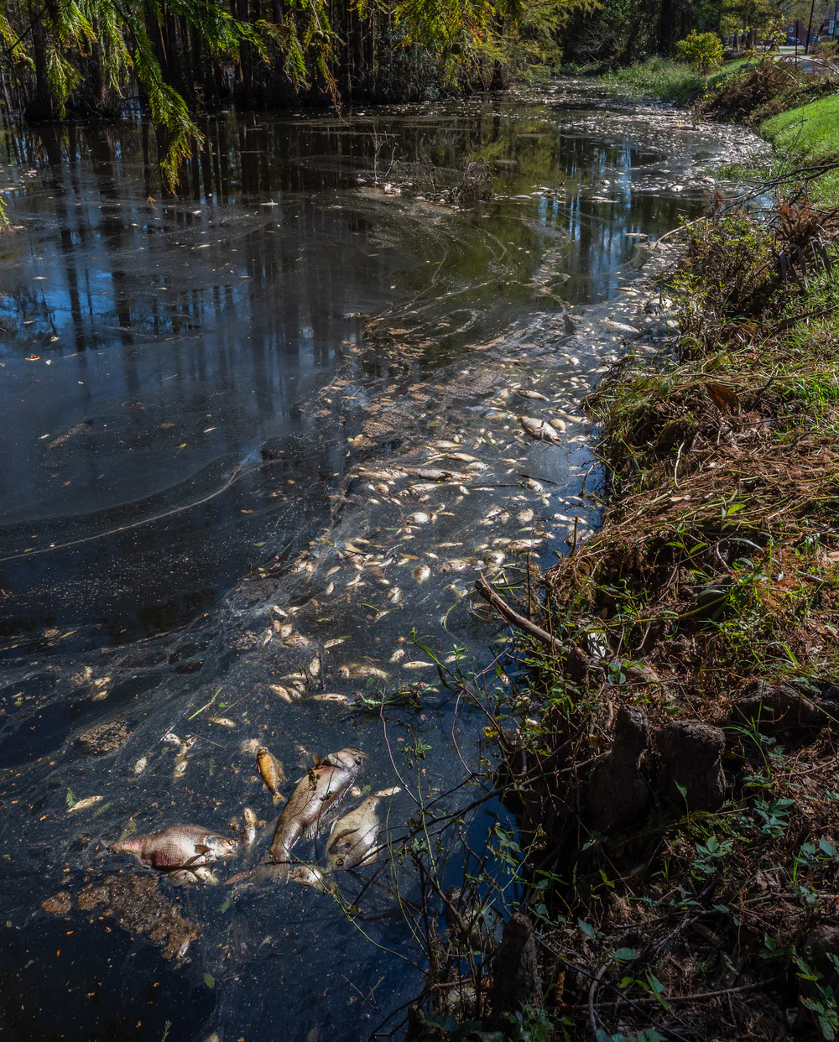
Sediments
Sediments - rivers carry sand, rocks, mud and decomposing plant and animal material to new places.

Slide 13
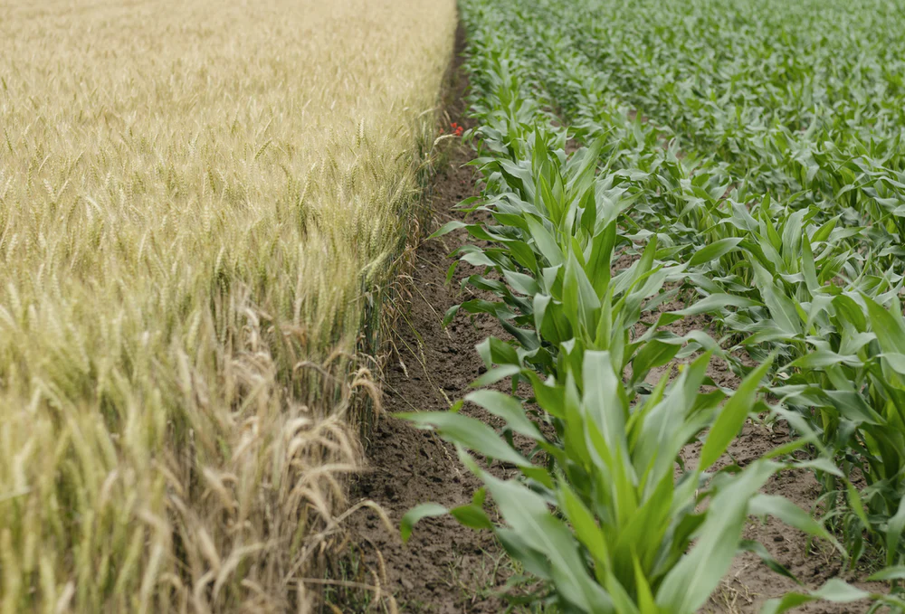
Agriculture
Agriculture - growing crops for food and money.

